Slide 1

QUIZ GAME DEVELOP IN PYTHON
Ganesh Reddy

Slide 2
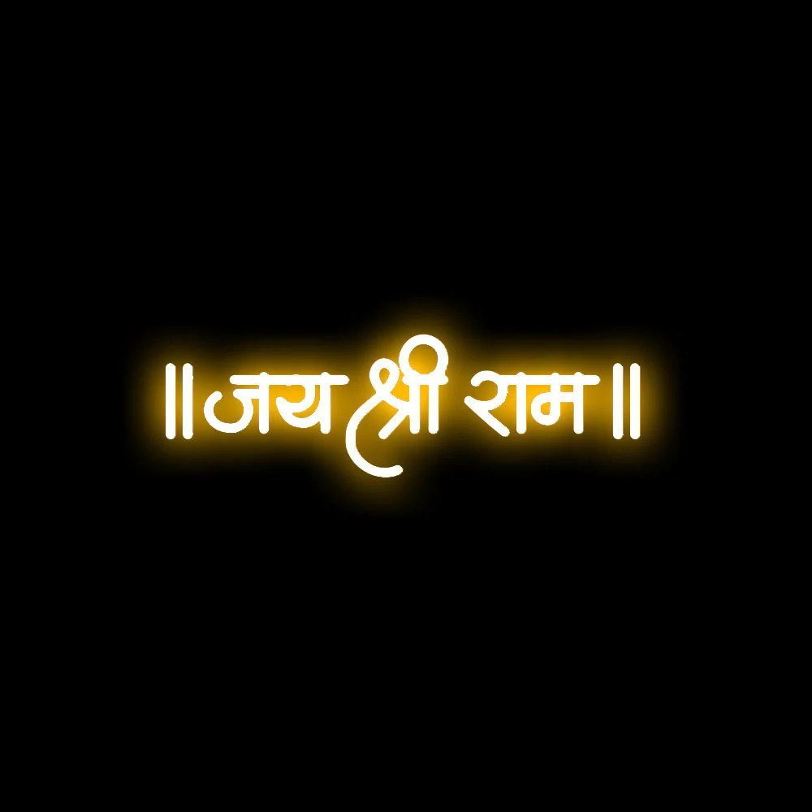
Agenda
INTRO
TECHNOLOGY
OUTPUT SLIDES
OUTPUT VIDEO
GIT HUB link

Slide 3



introduction
" Quiz" is an interactive and engaging game designed to test your knowledge of the Ramayana, one of the most cherished epics in Indian mythology. This quiz adventure takes you through key events, characters, and teachings from the Ramayana, offering an opportunity to delve deeper into this profound tale.

Slide 4
technology
Technology :
Powered by Python, a versatile and dynamic programming language, "Ramayana Quiz" delivers a seamless and user-friendly experience. Python's efficiency ensures smooth navigation, enabling players to explore the captivating world of Ramayana without any glitches.

Slide 5
modules
Tkinter
Pygame
Tkvideo
Moviepy

Slide 6
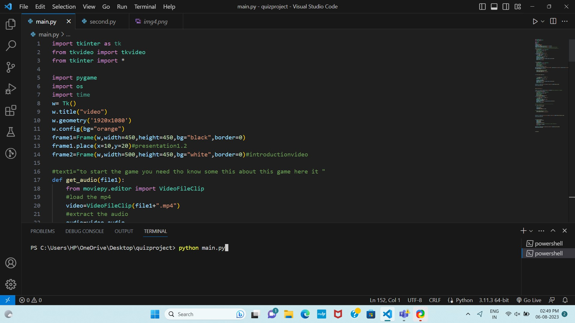
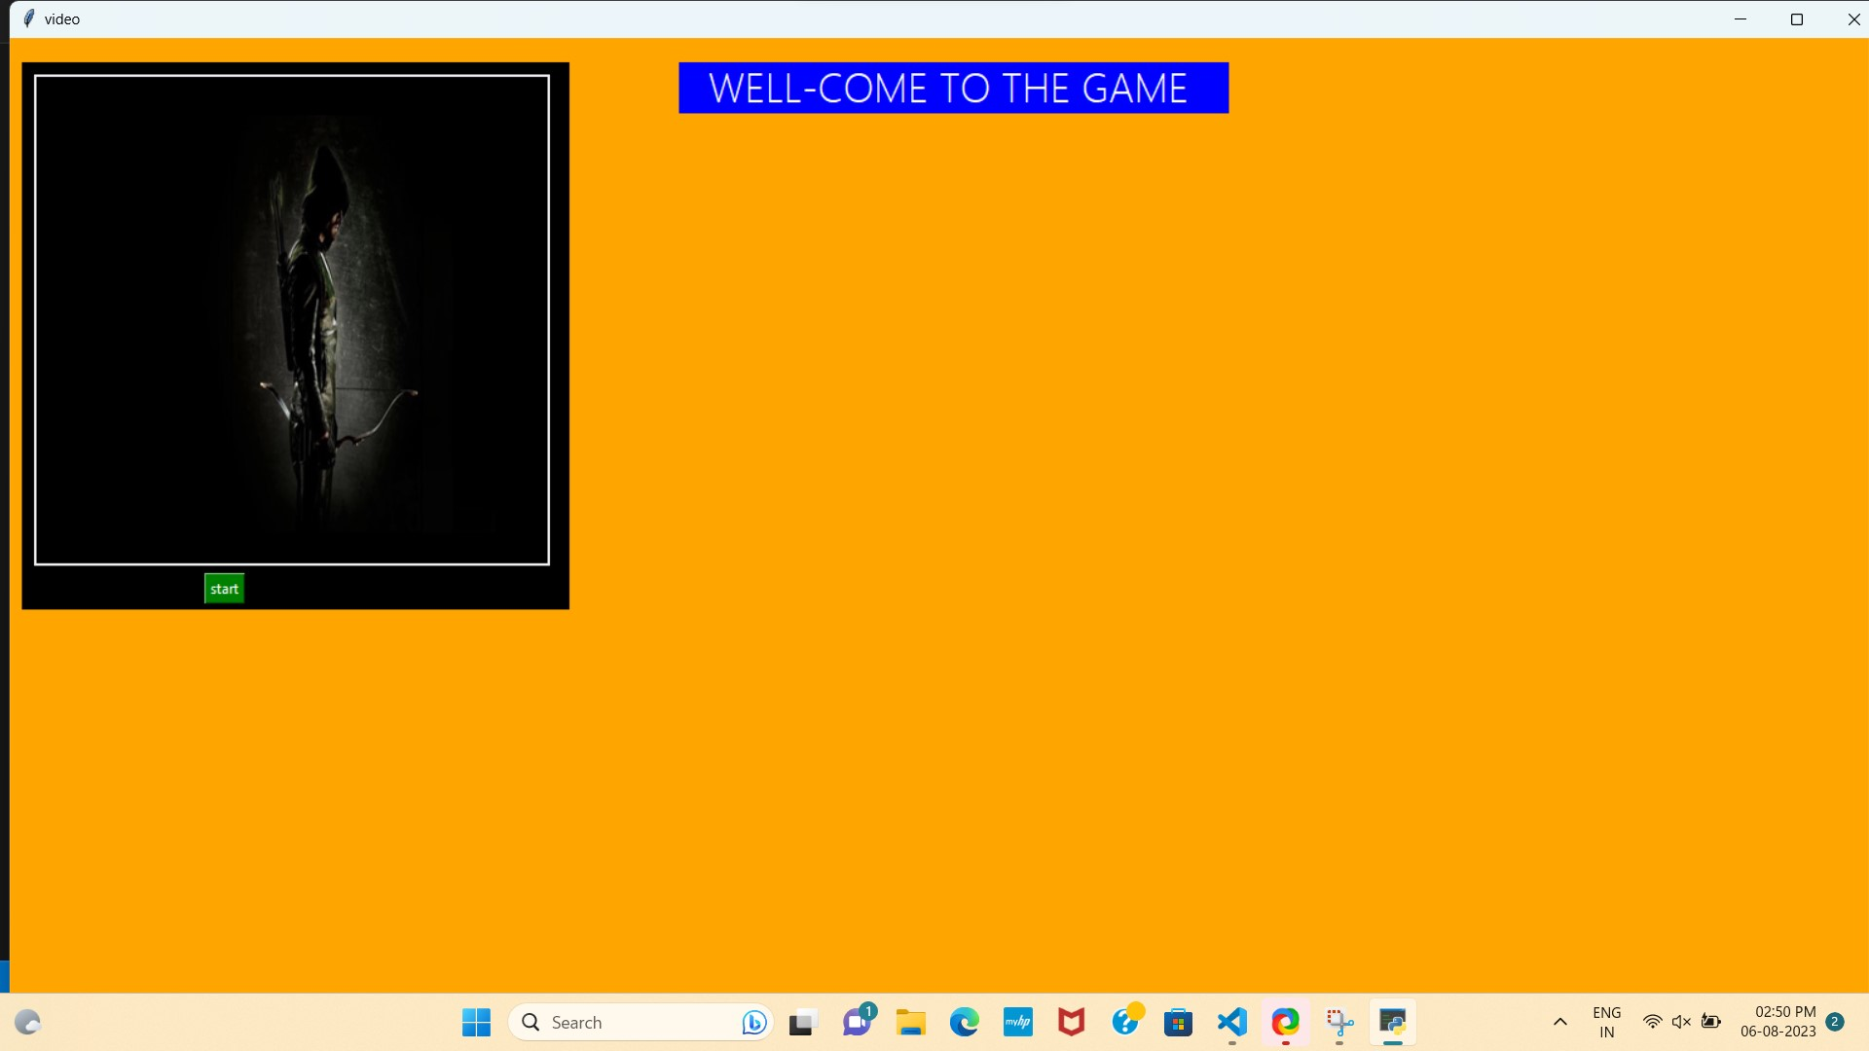
output

Slide 7
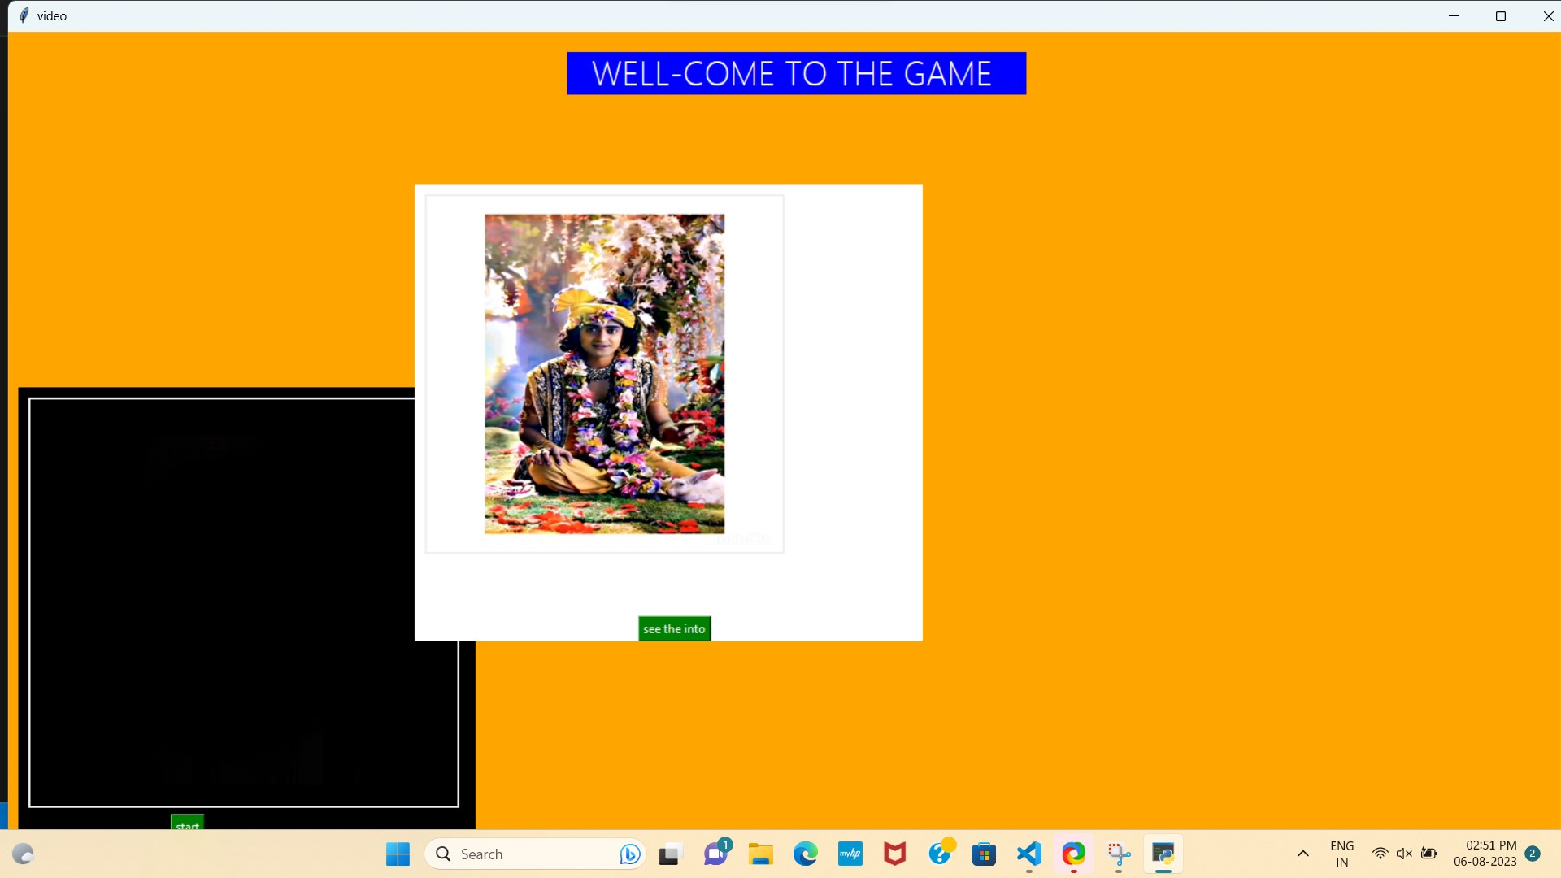
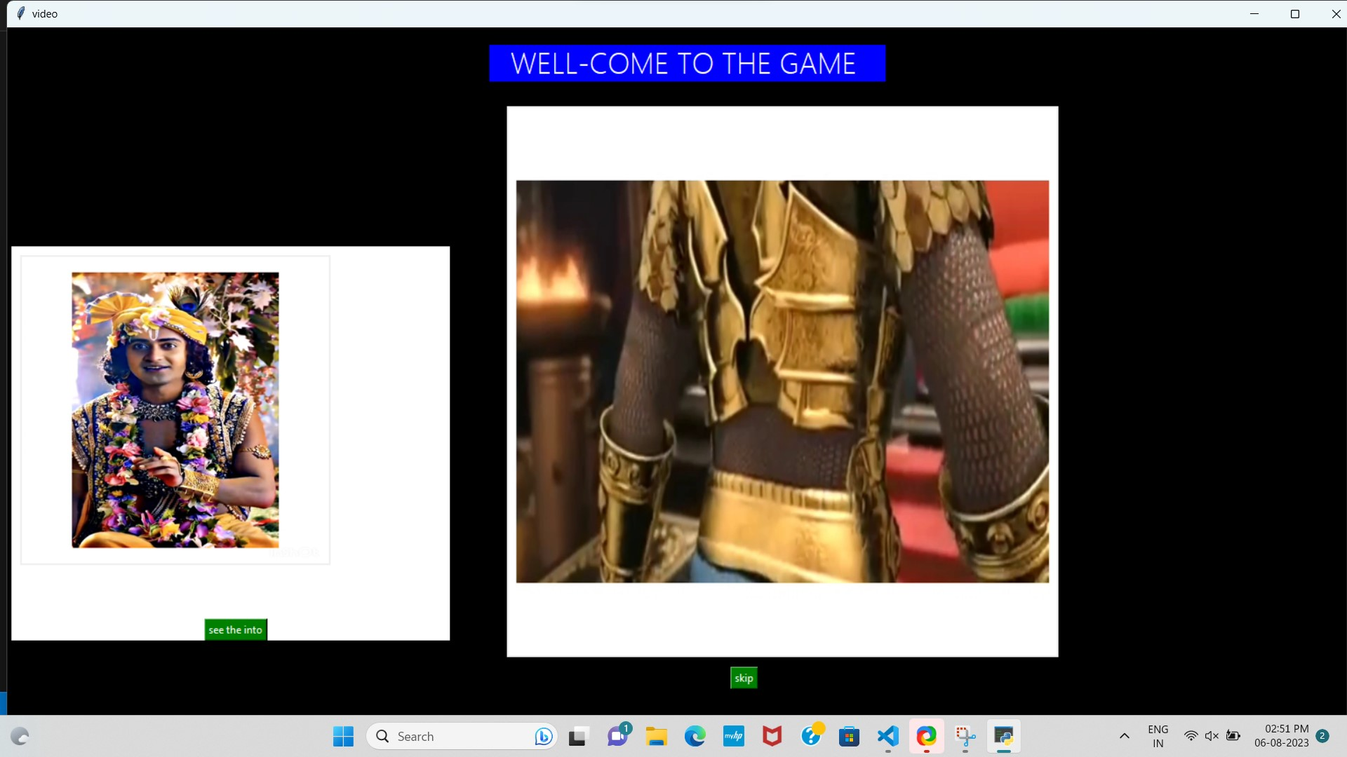
2.On click start
3.On click see intro

Slide 8
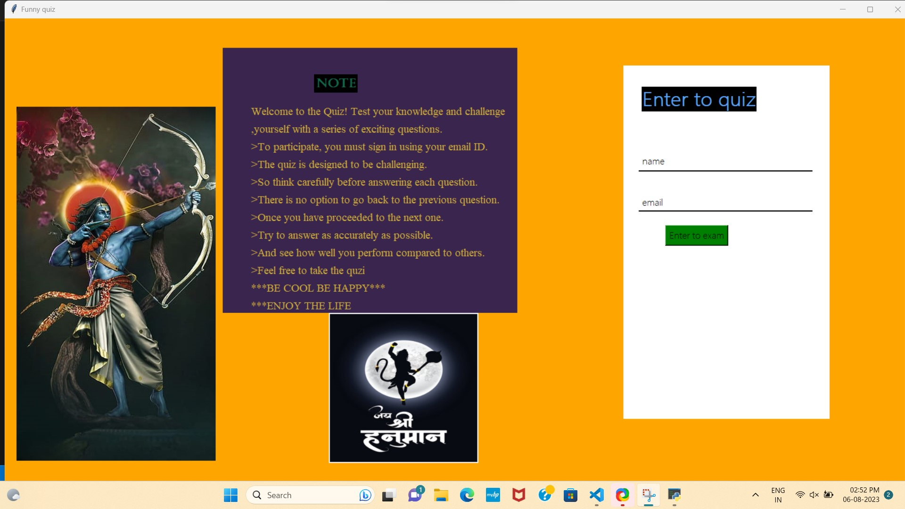
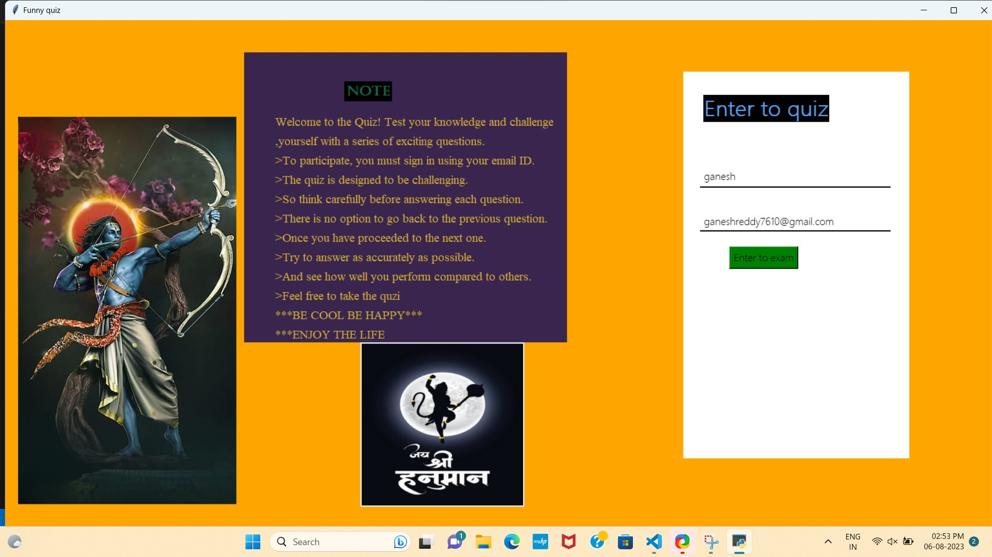
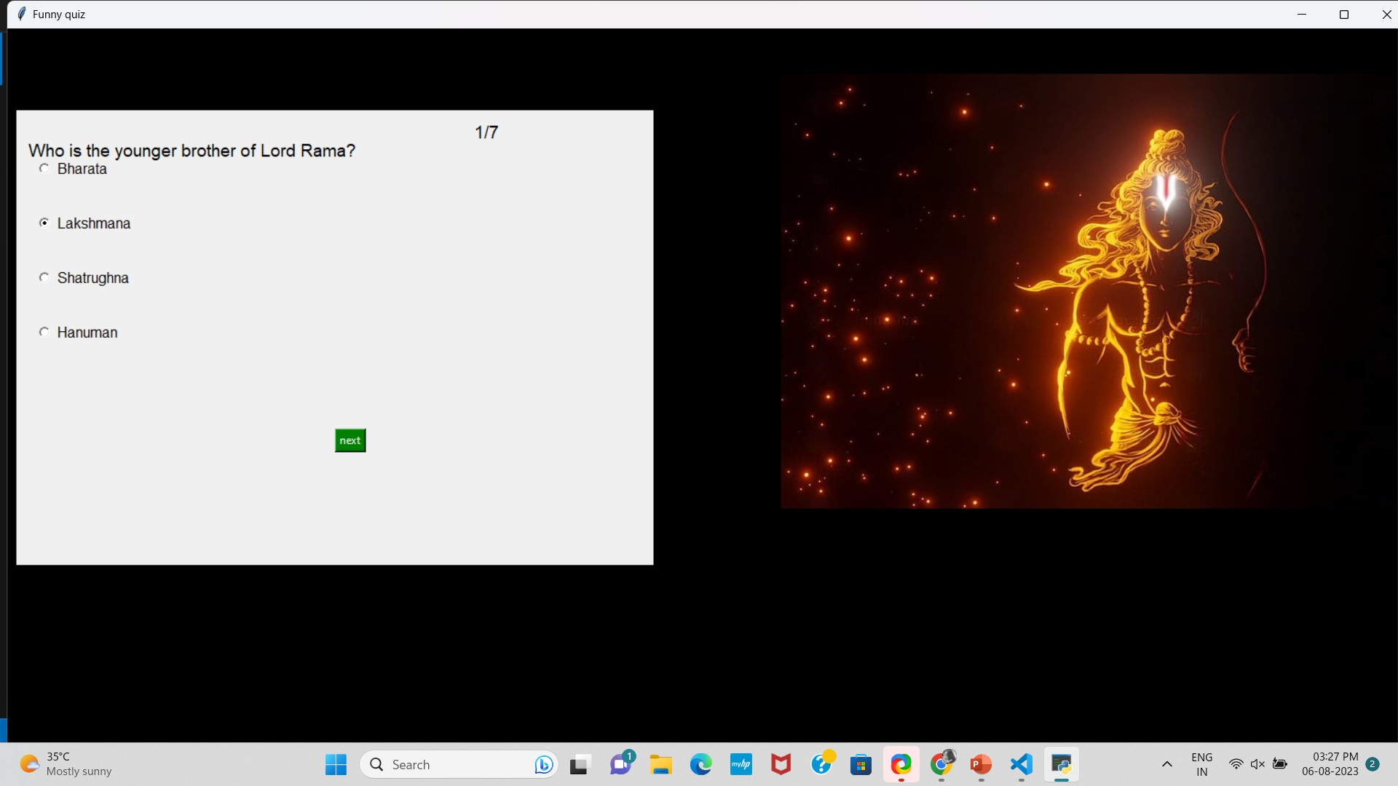
5. On click on “enter to exam” the exam page will display
4.On click “skip” this window will display

Slide 9
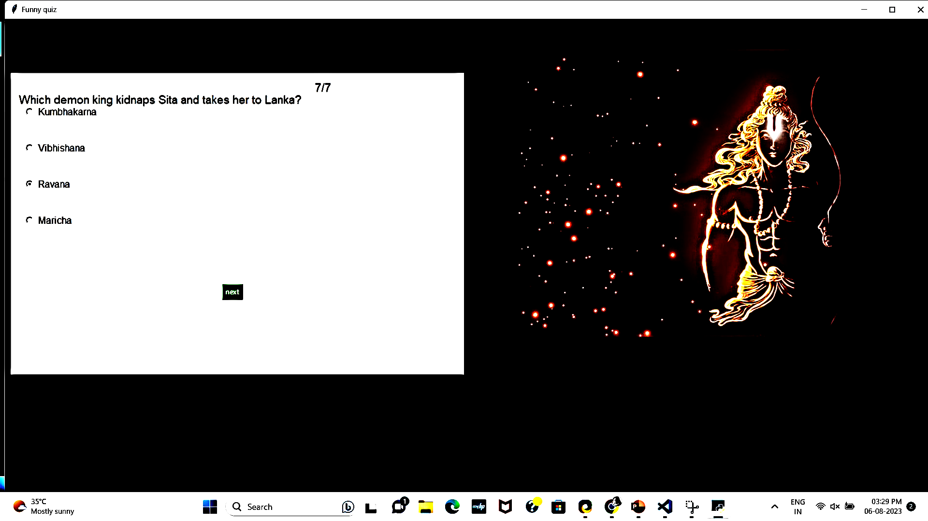
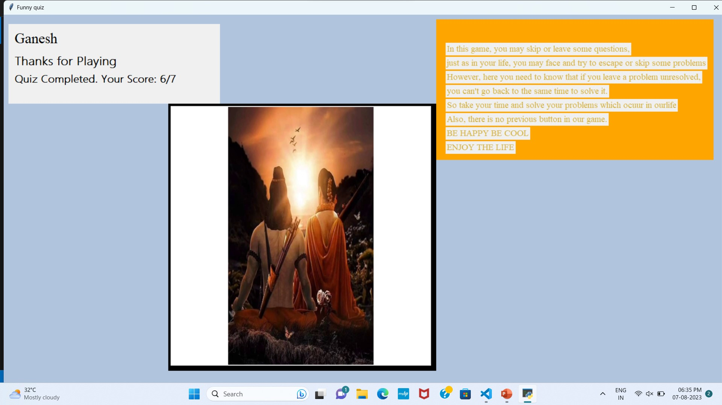
7.On click “next” at finial question the result will display
6. On click “next “ the next question will display and save the previous question answer.

Slide 10
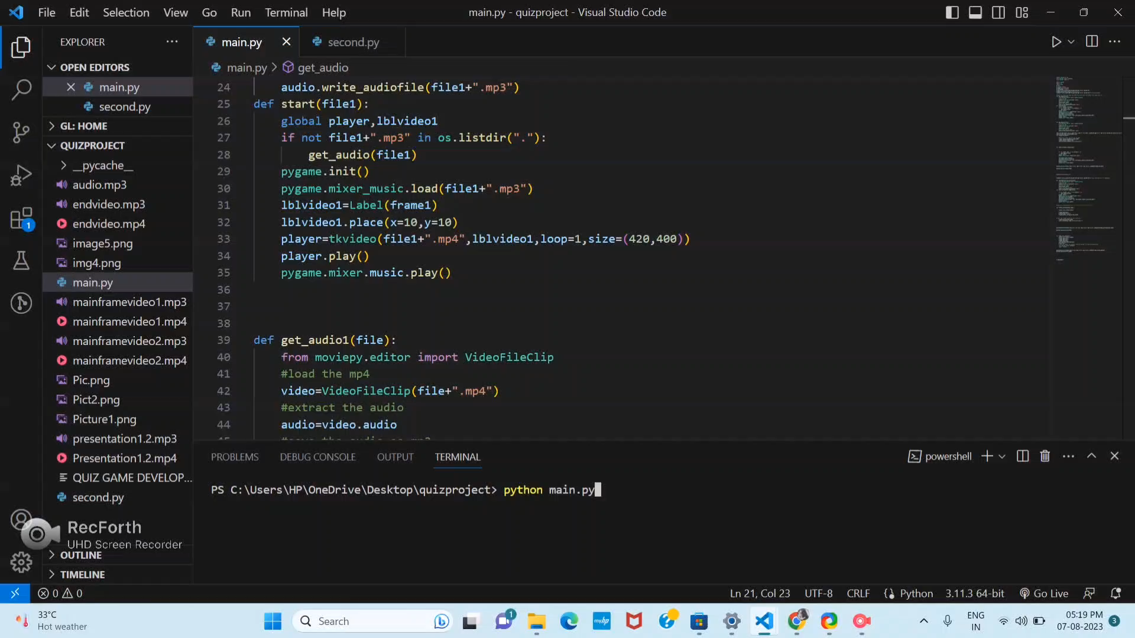
Output video

Slide 11

Thank you
Presenter Name
Ganesh Reddy
Email Address
ganeshreddy7610@gamil.com
Website Address

